Slide 1
Linear Regression using Normal Equation

Slide 2
Overview
Introduction
Steps
Implementation
References

Slide 3
Introduction

Slide 4
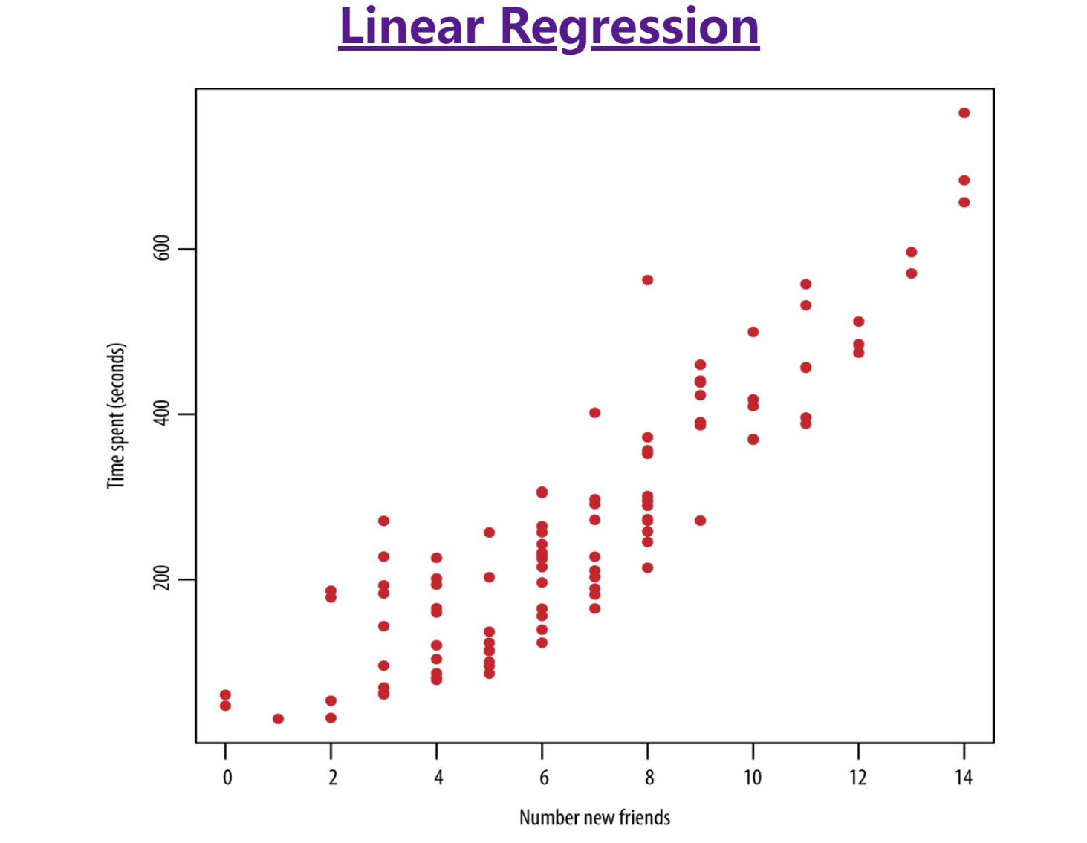
Introduction

Slide 5
Introduction
Meaning
The linear regression using normal equation is a method for solving a linear regression problem. It involves finding the line of best fit for a set of data points, where the line is defined by an equation of the form y = mx + b. The "normal equation" is a mathematical formula used to find the line that best fits the data. The equation is solved using matrix algebra, which provides an efficient and accurate solution.

Slide 6
Steps

Slide 7
Steps
Prepare the data: Organize the data in a matrix form with the independent variable as the first column and the dependent variable as the second column.
Calculate the design matrix X: The design matrix is a matrix that contains all the independent variables in the data.
Calculate the transpose of X: Transpose the design matrix X to get X transpose (X^T).
Multiply X transpose with X: Multiply X transpose with X to get (X^T)X.
Invert (X^T)X: Calculate the inverse of (X^T)X to get [(X^T)X]^-1.
Multiply [(X^T)X]^-1 with X transpose: Multiply [(X^T)X]^-1 with X transpose to get [(X^T)X]^-1(X^T).

Slide 8
Steps
Multiply [(X^T)X]^-1(X^T) with y: Multiply [(X^T)X]^-1(X^T) with the dependent variable y to get the coefficients of the linear regression equation.
Write the linear regression equation: Use the coefficients obtained in step 7 to write the linear regression equation in the form y = mx + b.
These are the basic steps to solve linear regression using the normal equation. By following these steps, you can find the line of best fit for your data and use it to make predictions.

Slide 9
Implementation

Slide 10
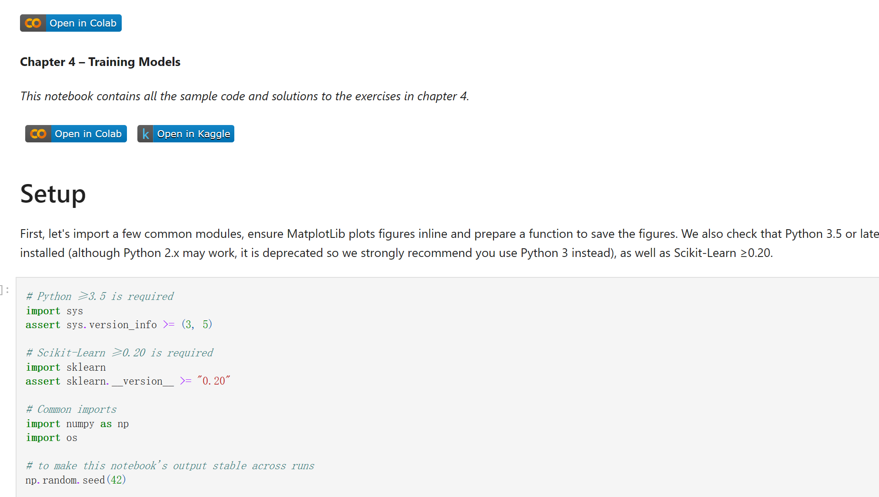
Implementation

Slide 11
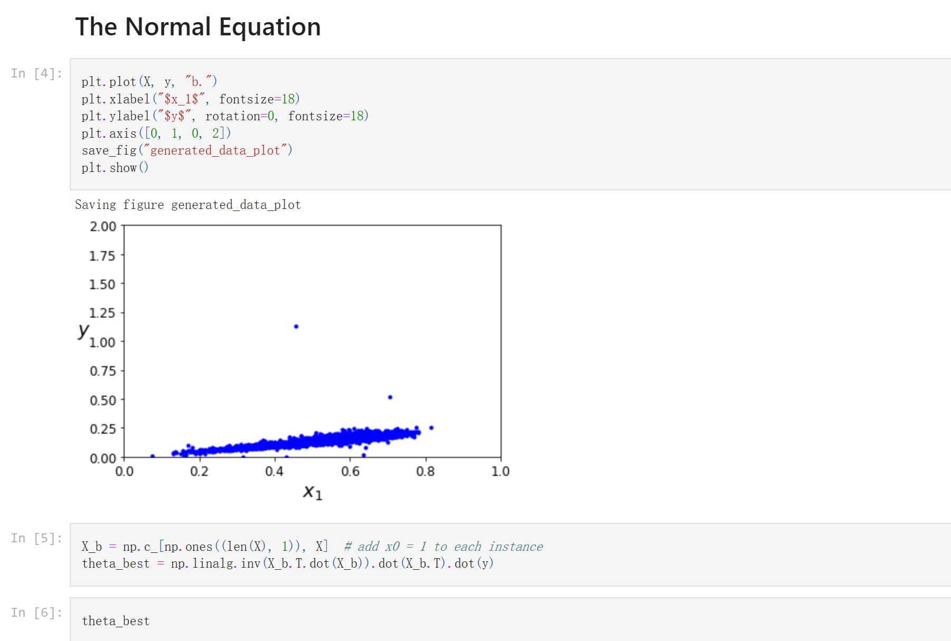
Implementation

Slide 12
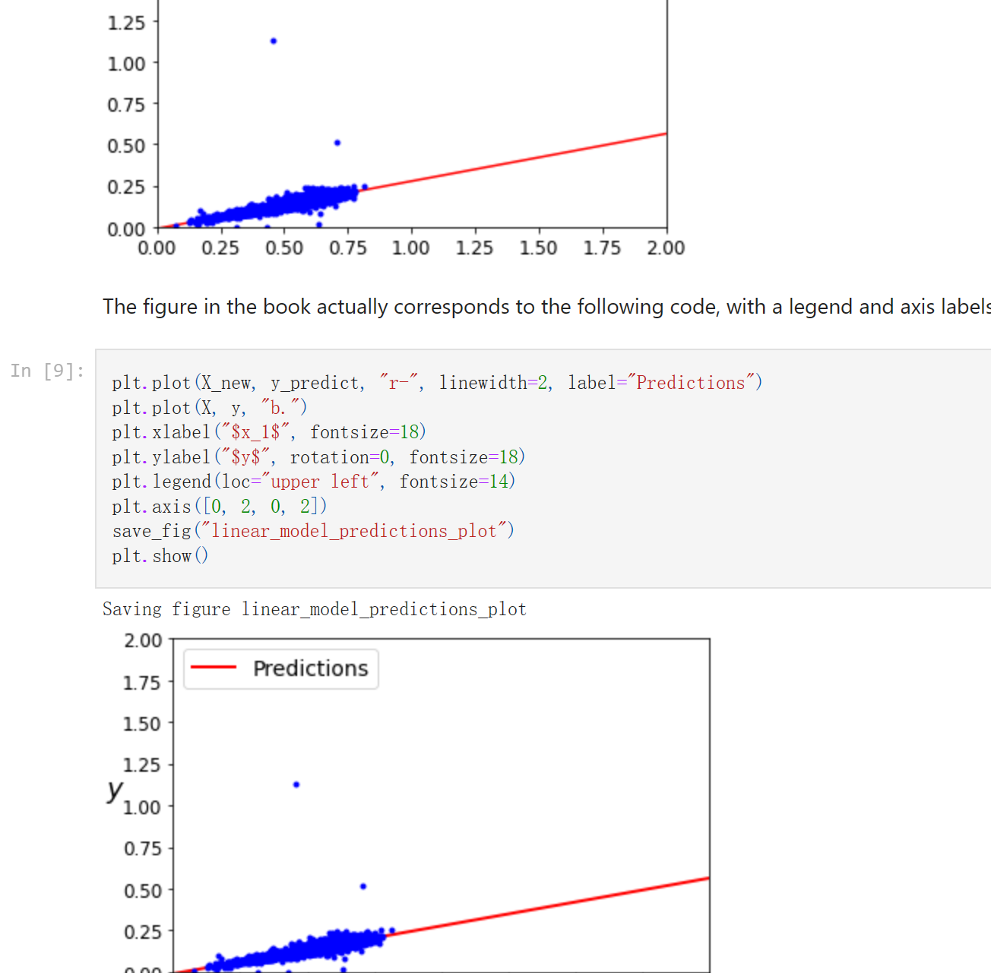
Implementation

Slide 13
References
https://hc.labnet.sfbu.edu/~henry/sfbu/course/hands_on_ml_with_schikit_2nd/train_model/slide/Linear_Regression.html

